Slide 1
Advance Java
J2EE

Slide 2
What is J2EE ?
J2EE is a platform-independent, Java-centric environment from Sun for developing, building and deploying Web-based enterprise applications online. The J2EE platform consists of a set of services, APIs, and protocols that provide the functionality for developing multitiered, Web-based applications.
The Java Platform, Enterprise Edition (Java EE) is a collection of Java APIs owned by Oracle that software developers can use to write server-side applications. It was formerly known as Java 2 Platform, Enterprise Edition, or J2EE.

Slide 3
List of technology which makes up J2EE
Java Servlets.
JavaServer Pages (JSP)
Enterprise JavaBeans (EJB)
Java Message Service (JMS)
Java Naming and Directory Interface (JNDI)
Java Database Connectivity (JDBC)
JavaMail.
Java Transaction Service (JTS)
JSF(Java Server Faces)

Slide 4
Introduction to Servlet
Servlet technology is used to create web application (resides at server side and generates dynamic web page).
Servlet technology is robust and scalable because of java language.
Before Servlet, CGI (Common Gateway Interface) scripting language was popular as a server-side programming language.
There are many interfaces and classes in the servlet API such as Servlet, GenericServlet, HttpServlet, ServletRequest, ServletResponse etc.

Slide 5
What is Servlet ?
Servlet can be described in many ways, depending on the context.
Servlet is a technology i.e. used to create web application.
Servlet is an API that provides many interfaces and classes including documentations.
Servlet is an interface that must be implemented for creating any servlet.
Servlet is a class that extend the capabilities of the servers and respond to the incoming request. It can respond to any type of requests.
Servlet is a web component that is deployed on the server to create dynamic web page.

Slide 6
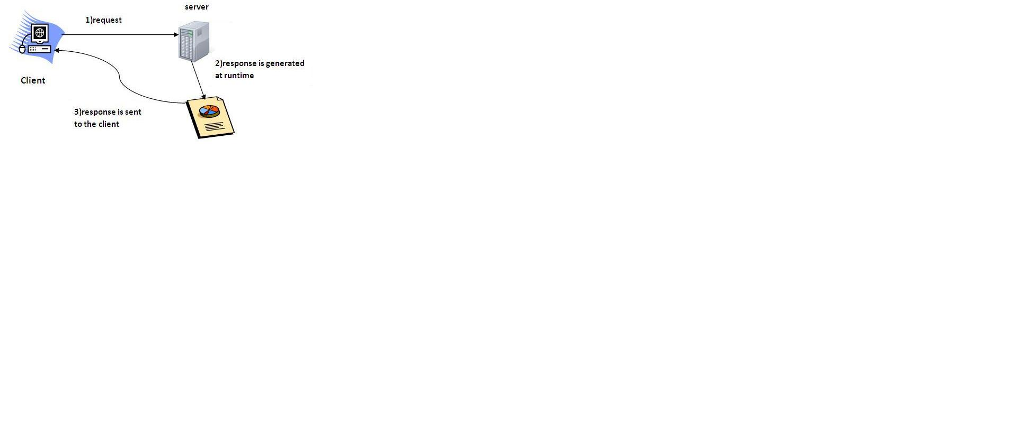
Servlet Architecture

Slide 7
What is web application?
A web application is an application accessible from the web. A web application is composed of web components like Servlet, JSP, Filter etc. and other components such as HTML. The web components typically execute in Web Server and respond to HTTP request.

Slide 8
CGI(Commmon Gateway Interface) for dynamic web apps.(ancient technology)
CGI technology enables the web server to call an external program and pass HTTP request information to the external program to process the request. For each request, it starts a new process.

Slide 9
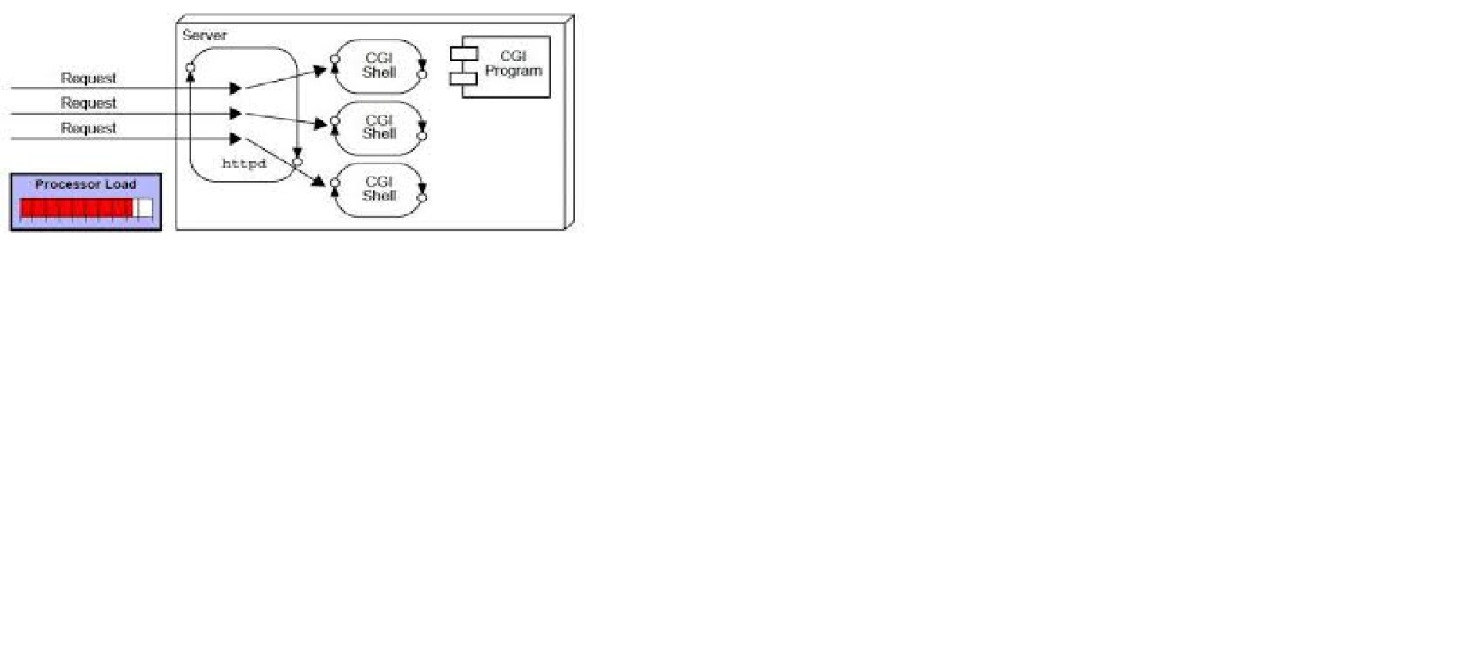
CGI

Slide 10
Disadvantages of CGI
There are many problems in CGI technology:
If number of clients increases, it takes more time for sending response.
For each request, it starts a process and Web server is limited to start processes.
It uses platform dependent language e.g. C, C++, perl.

Slide 11
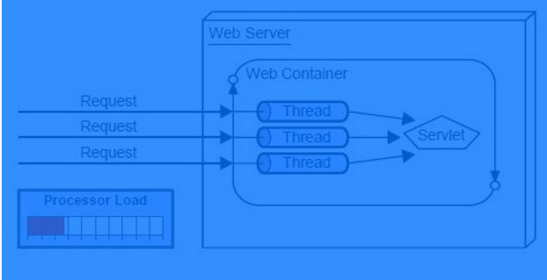
Advantage of Servlet

Slide 12
Continue…
There are many advantages of servlet over CGI. The web container creates threads for handling the multiple requests to the servlet. Threads have a lot of benefits over the Processes such as they share a common memory area, lightweight, cost of communication between the threads are low. The basic benefits of servlet are as follows:
better performance: because it creates a thread for each request not process.
Portability: because it uses java language.
Robust: Servlets are managed by JVM so we don't need to worry about memory leak, garbage collection etc.
Secure: because it uses java language..

Slide 13
Web Terminology
Servlet TerminologyDescriptionWebsite: static vs dynamicIt is a collection of related web pages that may contain text, images, audio and video.HTTPIt is the data communication protocol used to establish communication between client and server.HTTP RequestsIt is the request send by the computer to a web server that contains all sorts of potentially interesting information.Get vs PostIt give the difference between GET and POST request.ContainerIt is used in java for dynamically generate the web pages on the server side.Server: Web vs ApplicationIt is used to manage the network resources and for running the program or software that provides services.Content TypeIt is HTTP header that provides the description about what are you sending to the browser.

Slide 14
Website
Website is a collection of related web pages that may contain text, images, audio and video. The first page of a website is called home page. Each website has specific internet address (URL) that you need to enter in your browser to access a website.
Website is hosted on one or more servers and can be accessed by visiting its homepage using a computer network. A website is managed by its owner that can be an individual, company or an organization.

Slide 15
Types of website
A website can be of two types:
Static Website
Dynamic Website

Slide 16
Static website
Static website
Static website is the basic type of website that is easy to create. You don't need web programming and database design to create a static website. Its web pages are coded in HTML.
The codes are fixed for each page so the information contained in the page does not change and it looks like a printed page.

Slide 17
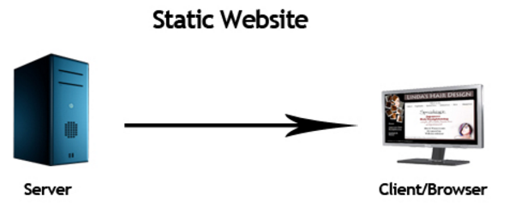
Continue…

Slide 18
Dynamic website
Dynamic website is a collection of dynamic web pages whose content changes dynamically.
It accesses content from a database or Content Management System (CMS).
Therefore, when you alter or update the content of the database, the content of the website is also altered or updated.
Dynamic website uses client-side scripting or server-side scripting, or both to generate dynamic content.
Client side scripting generates content at the client computer on the basis of user input.
The web browser downloads the web page from the server and processes the code within the page to render information to the user.
In server side scripting, the software runs on the server and processing is completed in the server then plain pages are sent to the user.

Slide 19
HTTP (Hyper Text Transfer Protocol)
The Hypertext Transfer Protocol (HTTP) is application-level protocol for collaborative, distributed, hypermedia information systems.
It is the data communication protocol used to establish communication between client and server.
HTTP is TCP/IP based communication protocol, which is used to deliver the data like image files, query results, HTML files etc on the World Wide Web (WWW) with the default port is TCP 80.
It provides the standardized way for computers to communicate with each other.

Slide 20
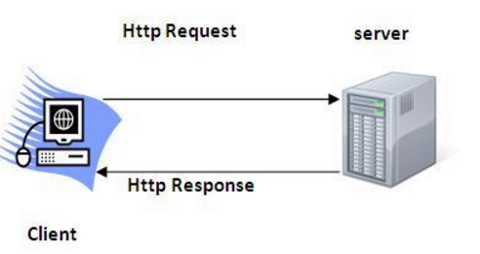
HTTP

Slide 21
The Basic Characteristics of HTTP
It is the protocol that allows web servers and browsers to exchange data over the web.
It is a request response protocol.
It uses the reliable TCP connections by default on TCP port 80.
It is stateless means each request is considered as the new request.
In other words, server doesn't recognize the user by default.

Slide 22
The Basic Features of HTTP (Hyper Text Transfer Protocol):
There are three fundamental features that make the HTTP a simple and powerful protocol used for communication:
HTTP is media independent: It refers to any type of media content can be sent by HTTP as long as both the server and the client can handle the data content.
HTTP is connectionless: It is a connectionless approach in which HTTP client i.e., a browser initiates the HTTP request and after the request is sends the client disconnects from server and waits for the response.
HTTP is stateless: The client and server are aware of each other during a current request only. Afterwards, both of them forget each other. Due to the stateless nature of protocol, neither the client nor the server can retain the information about different request across the web pages.

Slide 23
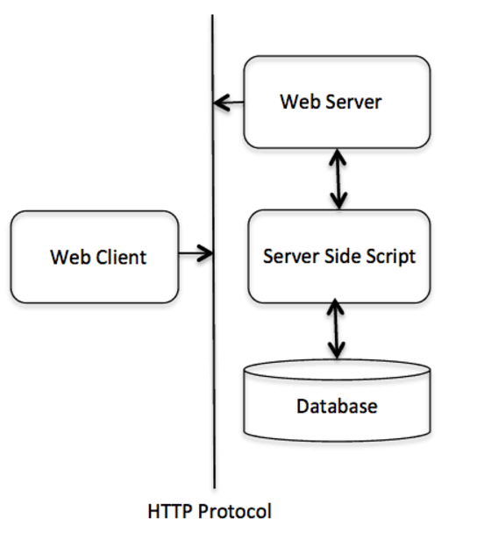
The Basic Architecture of HTTP

Slide 24
Continue…
HTTP is request/response protocol which is based on client/server based architecture.
In this web browser, search engines, etc behaves as a HTTP clients, and the Web server like Servlet behaves as a server.

Slide 25
HTTP Requests
The request sends by the computer to a web server that contains all sorts of potentially interesting information is known as HTTP requests.

Slide 26
What it send to HTTP ?
The HTTP client sends the request to the server in the form of request message which includes following information:
The Request-line
The analysis of source IP address, proxy and port
The analysis of destination IP address, protocol, port and host
The Requested URI (Uniform Resource Identifier)
The Request method and Content
The User-Agent header
The Connection control header
The Cache control header

Slide 27
Continue…
The HTTP request method indicates the method to be performed on the resource identified by the Requested URI (Uniform Resource Identifier). This method is case-sensitive and should be used in uppercase.
Like turn over next….

Slide 28
The HTTP Request Methods.
Method | Description
GET | Asks to get the resource at the requested URL.
POST | Asks the server to accept the body info attached. It is like GET request with extra info sent with the request.
HEAD | Asks for only the header part of whatever a GET would return. Just like GET but with no body.
TRASE | Asks for the loopback of the request message, for testing or troubleshooting.
PUT | Says to put the enclosed info (the body) at the requested URL.
DELETE | Says to delete the resource at the requested URL.
OPTION | Asks for a list of the HTTP methods to which the thing at the request URL can respond

Slide 29
GET and POST
Two common methods for the request-response between a server and client are:
GET- It requests the data from a specified resource
POST- It submits the processed data to a specified resource

Slide 30
Get vs. Post
GET | POST
1) In case of Get request, only limited amount of data can be sent because data is sent in header. | In case of post request, large amount of data can be sent because data is sent in body.
2) Get request is not secured because data is exposed in URL bar. | Post request is secured because data is not exposed in URL bar.
3)Get request can be bookmarked. | Post request cannot be bookmarked.
4) Get request is idempotent . It means second request will be ignored until response of first request is delivered | Post request is non-idempotent.
5) Get request is more efficient and used more than Post. | Post request is less efficient and used less than get.

Slide 31
Anatomy of GET Request
The query string (name/value pairs) is sent inside the URL of a GET request:
GET /RegisterDao.jsp?name1=value1&name2=value2

Slide 32
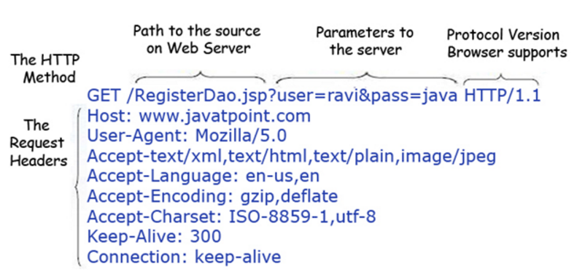
Continue…

Slide 33
Some other features of GET requests are:
Some other features of GET requests are:
It remains in the browser history
It can be bookmarked
It can be cached
It have length restrictions
It should never be used when dealing with sensitive data
It should only be used for retrieving the data

Slide 34
Anatomy of Post Request
The query string (name/value pairs) is sent in HTTP message body for a POST request:
POST/RegisterDao.jsp HTTP/1.1
Host: www. XYZ.com
name1=value1&name2=value2

Slide 35
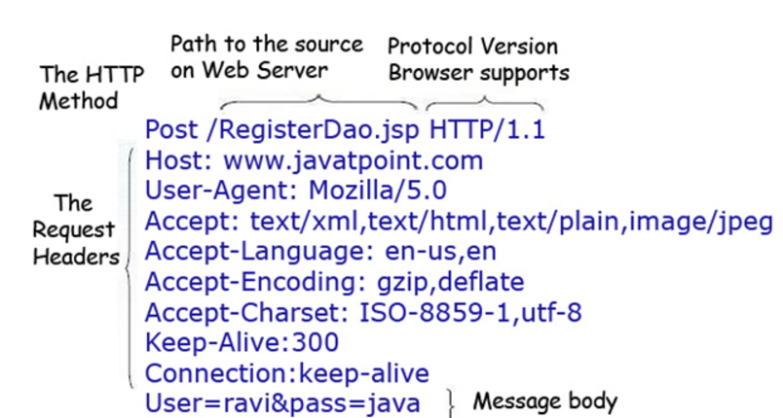
Continue…

Slide 36
Some other features of POST requests are:
This requests cannot be bookmarked
This requests have no restrictions on length of data
This requests are never cached
This requests do not remains in the browser history

Slide 37
Servlet Container
It provides the runtime environment for JavaEE (j2ee) applications.
The client/user can request only a static WebPages from the server.
If the user wants to read the web pages as per input then the servlet container is used in java.
The servlet container is used in java for dynamically generate the web pages on the server side.
Therefore the servlet container is the part of a web server that interacts with the servlet for handling the dynamic web pages from the client.

Slide 38
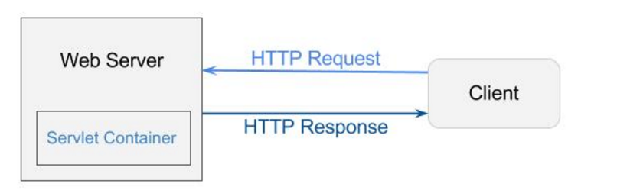
Image…

Slide 39
Servlet Container States
he servlet container is the part of web server which can be run in a separate process.
Basically 3 type of servlet container
Standalone: It is typical Java-based servers in which the servlet container and the web servers are the integral part of a single program.
For example:- Tomcat running by itself
In-process: It is separated from the web server, because a different program is runs within the address space of the main server as a plug-in.
For example:- Tomcat running inside the JBoss.
Out-of-process: The web server and servlet container are different programs which are run in a different process.
For performing the communications between them, web server uses the plug-in provided by the servlet container.

Slide 40
The Servlet Container performs many operations that are given below:
Life Cycle Management
Multithreaded support
Object Pooling
Security etc.

Slide 41
Server: Web vs. Application
Server is a device or a computer program that accepts and responds to the request made by other program, known as client. It is used to manage the network resources and for running the program or software that provides services.
There are two types of servers:
Web Server
Application Server

Slide 42
Web Server
Web server contains only web or servlet container. It can be used for servlet, jsp, struts, jsf etc. It can't be used for EJB.
It is a computer where the web content can be stored. In general web server can be used to host the web sites but there also used some other web servers also such as FTP, email, storage, gaming etc.
Examples of Web Servers are: Apache Tomcat and Resin etc….

Slide 43
Web Server Working
It can respond to the client request in either of the following two possible ways:
Generating response by using the script and communicating with database.
Sending file to the client associated with the requested URL.

Slide 44
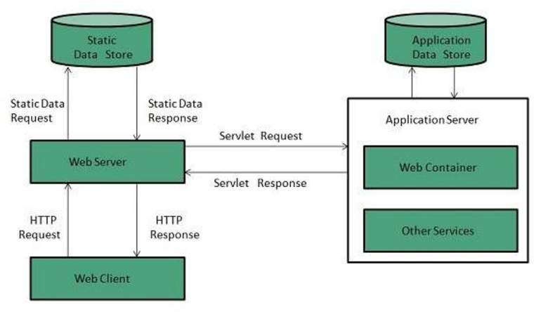
The block diagram representation of Web Server is shown below:

Slide 45
Important points
If the requested web page at the client side is not found, then web server will sends the HTTP response: Error 404 Not found.
When the web server searching the requested page if requested page is found then it will send to the client with an HTTP response.
If the client requests some other resources then web server will contact to application server and data is store for constructing the HTTP response.

Slide 46
Application Server
Application server contains Web and EJB containers. It can be used for servlet, jsp, struts, jsf, ejb etc.
It is a component based product that lies in the middle-tier of a server centric architecture.
It provides the middleware services for state maintenance and security, along with persistence and data access.
It is a type of server designed to install, operate and host associated services and applications for the IT services, end users and organizations.

Slide 47
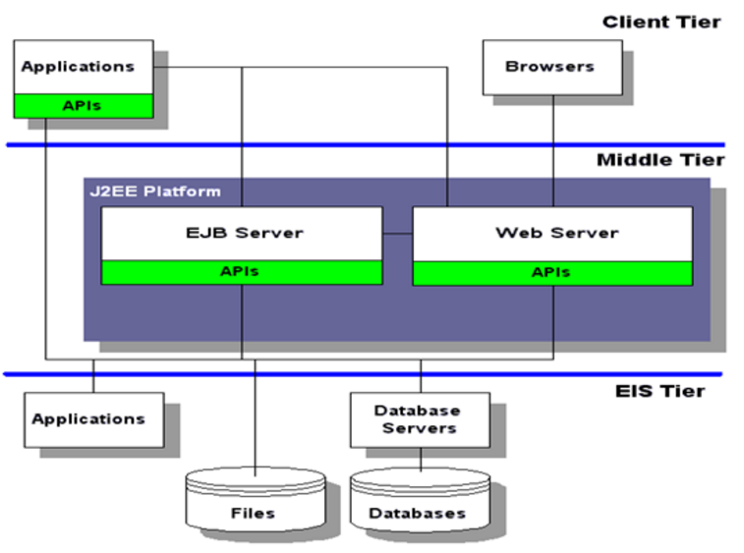
Block Diagram for Application server

Slide 48
The Example of Application Servers are:
Boss: Open-source server from JBoss community.
Glassfish: Provided by Sun Microsystem. Now acquired by Oracle.
Weblogic: Provided by Oracle. It more secured.
Websphere: Provided by IBM.

Slide 49
Content Type
Content Type is also known as MIME (Multipurpose internet Mail Extension) Type.
It is a HTTP header that provides the description about what are you sending to the browser.
MIME is an internet standard that is used for extending the limited capabilities of email by allowing the insertion of sounds, images and text in a message.
The features provided by MIME to the email services are as given below:
It supports the non-ASCII characters
It supports the multiple attachments in a single message
It supports the attachment which contains executable audio, images and video files etc.
It supports the unlimited message length.

Slide 50
List of Content Types
text/html
text/plain
application/msword
application/vnd.ms-excel
application/jar
application/pdf
application/octet-stream
application/x-zip
images/jpeg
images/png
images/gif
audio/mp3
video/mp4
video/quicktime etc.

